Slide 1
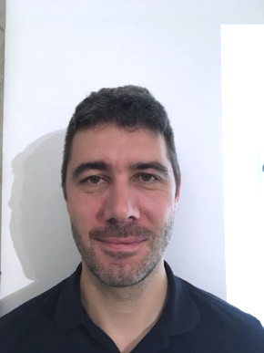

Resume
Anthony CAUMOND
20⁺ years of experience
Profile
During my career, computing has been my preferred innovation vector. After a few years building "demos", I did protos with industries (PSA | Michelin | Eramet). The prototypes were fun, but I targeted the industry to be where the decisions are taken. After some years there, I search for a place where I can use my knowledge and innovate
Contact (+33) 6 65 25 02 79 caumond@gmail.com France (Clermont-Fd) | Training Université d’Auvergne, 2005 - Operations Research Ph.D. ISIMA, 2001 - Computer Science degree TOGAF & BASICS APICS certified
See my website for more details
Follow hyperlinks for public references and explanations
Experience based on my 3 pillars
 | Activity & Experiences | Supply Chain | Information Technology | Optimization
 | C.V. website |  | Clojure(script) in react
 | Product owner of an inhouse PLM Michelin | Creates, sell and materialize the vision Product lifecycle management tool Team leader | Clojure prototyping Application design
 | Enterprise Architect Supply Chain (group) Michelin | C-Level enterprise studies Software package purchasing Automotive ERP- Integrated Planning Framework studies for a major transformation program (what it is ?) S&OP framework & sourcing with JDA 1st attempt of group A.I. software purchase | Knowledge of Main Supply Chain software packages Practise of Enterprise Architecture Launch of an event streaming app (product owner)
 | IT Architect & S.C. Consultant Michelin | Business architecture Production planning solution expert BASICS certification | Solution Architecture
 | IT & Supply Chain Consultant Unilog | Distribution Requirement planning deployment, change management | PL SQL opt. tool – dis. netwok optimization C++ optimization tool – tactical optimization | Distribution network optimization (Busaker & gowen) Tactical planning (Iterative metaheuristics)
 | e-commerce website Family jewellery | Practical order to cash knowledge (web archive) | Php5 mysql paradox db Design & development Back & front-end
 | Operation Research PhD & Teacher Blaise Pascal University | Industrial Proof Of Concepts: PSA – Assembly line optimization PSA - Workshop optimization Eramet – Forging workshop optimization Michelin – Test tracks time tabling Michelin – Plant simulation | Borland C++ - UI Framework for iterative optimisation (chapter 5 of thesis) | Phd thesis & Articles : C.O.R : Time lag E.J.O.R. : Transportation Iterative methods Discrete event simulation & modelling Linear programming Graph optimization
 | Personal Activities |  | Demo making & games Stock management software Assembly Z80 & 68000
2021
2019
2016
2008
2006
2001

